Slide 1
Object Oriented Programming using Java (ECSE102L)

Slide 2
Outline
Sorting
Bubble Sort
Insertion Sort
Selection Sort

Slide 3
Sorting
S
Sorting is any process of arranging items systematically.
  Ordering: Arranging items in a sequence ordered by some criterion.
  Categorizing: Grouping items with similar properties.
Sorting can be done on names, numbers and records.
A sorting algorithm is used to rearrange the elements of a given array.

Slide 4
Why Sorting is Important?
S
To monitor data properly.
To improve efficiency.

Slide 5
Bubble Sort
S
Bubble sort is a simple and effective sorting algorithm.
Here, elements are placed adjacent to each other.
Bubble sort starts from one end (left side) and compares 2 adjacent elements.
It swaps the elements, if they are not in the correct order.
When we reaches the end of the elements (right side), it starts over until all the data is in the correct order.

Slide 6
Bubble Sort (Cont…)
S
Algorithm: Consider there are 5 unordered elements in the array.
Step1: Start with the first two elements and sort them in ascending order.
Step2: Compare the second and third elements to check which one is greater, and sort them in ascending order.
Step 3: Compare the third and fourth elements to check which one is greater, and sort them in ascending order.
Step 4: Compare the fourth and fifth element to check which one is greater, and sort them in ascending order.
Step 5: Repeat steps 1-5 until no more swaps are required.

Slide 7
Bubble Sort (Cont…)
S
Advantage:
  Easy to understand.
  Fast to implement.
Disadvantage:
  Can’t deal with a large set of data/element.
  Slow.

Slide 8
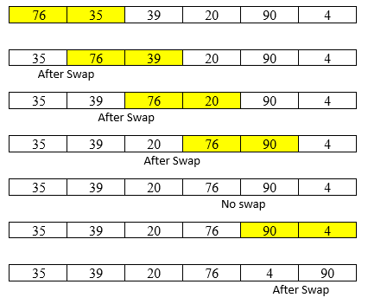
Bubble Sort (Cont…)
S
Example:
1st Iteration
76 | 35 | 39 | 20 | 90 | 4

Slide 9
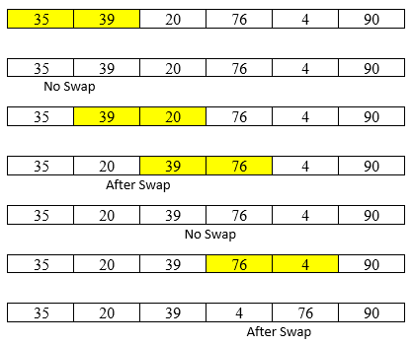
Bubble Sort (Cont…)
S
Example (Cont…):
2nd Iteration
76 | 35 | 39 | 20 | 90 | 4

Slide 10
Bubble Sort (Cont…)
S
Example (Cont…):
3rd Iteration
4th Iteration
5th Iteration
.
.
.
.
76 | 35 | 39 | 20 | 90 | 4

Slide 11
Bubble Sort (Cont…)
S
Example (Cont…):
  After 1st iteration only the highest element/value is sorted.
  After 2nd iteration two elements/values are sorted.
  And so on…

Slide 12
Bubble Sort (Cont…)
S
What if the elements are already sorted?
What if only a few elements are not sorted and after a couple of swap the elements get sorted?
  We can use a Boolean variable to determine if any swapping occurred or not.
  If no swapping occurred, then we know that the collection is already sorted.

Slide 13
Bubble Sort (Cont…)
S
Use Bubble Sort algorithm to sort the below elements:
27 | 54 | 43 | 58 | 19

Slide 14
Insertion Sort
S
It is a simple sorting algorithm that sorts an array/elements by shifting element one.
The array elements are compared with each other sequentially.
Insertion sort is adaptive i.e. it reduces its total number of steps, if a partially sorted array is given.
Here, each iteration moves an element from unsorted portion to sorted portion until all the elements are sorted in the list.

Slide 15
Insertion Sort (Cont…)
S
Algorithm:
Step 1: Let the first element in the list is in sorted portion and all the remaining elements are in unsorted portion.
Step 2: Select the first element from the unsorted portion and insert that element into the sorted portion in the order specified.
Step 3: Repeat the above process until all the elements from the unsorted portion are moved into the sorted portion.

Slide 16
Insertion Sort (Cont…)
S
Advantage
  Efficient for almost sorted array/elements.
  Simple implementation.
Disadvantage
  It is less efficient for an array/list containing more number of elements.
  When the number of elements increases, the performance is slow.

Slide 17
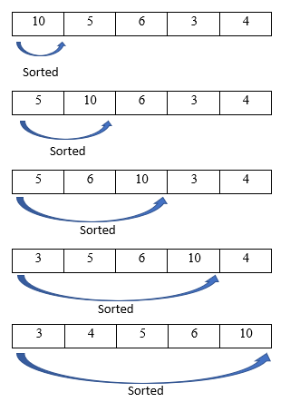
Insertion Sort (Cont…)
S
Example
10 | 5 | 6 | 3 | 4

Slide 18
Insertion Sort (Cont…)
S
Use Insertion Sort algorithm to sort the below elements:
17 | 24 | 12 | 35 | 45 | 22 | 6 | 49

Slide 19
Selection Sort
S
Selection sort algorithm is based on the idea of finding the minimum or maximum element in an unsorted array.
It selects the smallest element from an unsorted list in each iteration and places that element at the beginning of the unsorted list.

Slide 20
Selection Sort (Cont…)
S
Algorithm:
Step 1: Select the first element of the array.
Step 2: Compare the selected element with all the other elements in the list.
Step 3: In every comparison, if any element is found smaller than the selected element, both are swapped.
Step 4: Repeat the same procedure with element in the next position in the array till the entire array is sorted.

Slide 21
Selection Sort (Cont…)
S
Advantage
  Does not depend on the initial arrangement of the data.
  Simple implementation.
Disadvantage
  Many searches are required.

Slide 22
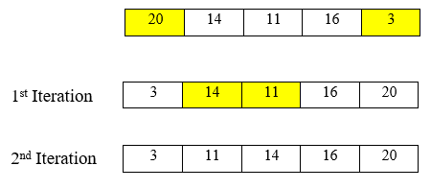
Selection Sort (Cont…)
S
Example
20 | 14 | 11 | 16 | 3

Slide 23
Selection Sort (Cont…)
S
Use Selection Sort algorithm to sort the below elements:
12 | 35 | 24 | 11 | 41 | 16 | 50 | 40

Slide 24




